Slide 1



Electronic Medical Records System
By Blaine Rudow

Slide 2
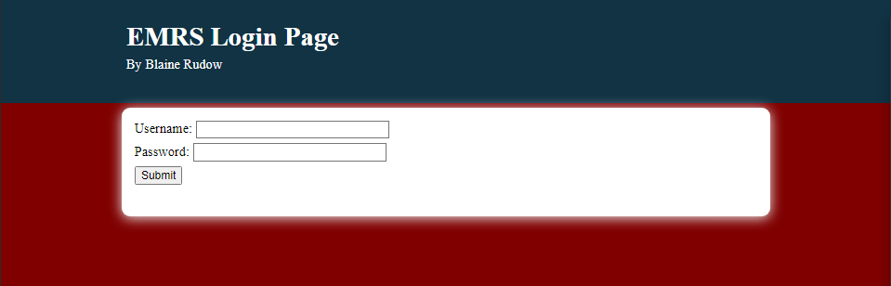
Login Page
User inputs username & password
Page redirects to Home page of the EMRS

Slide 3
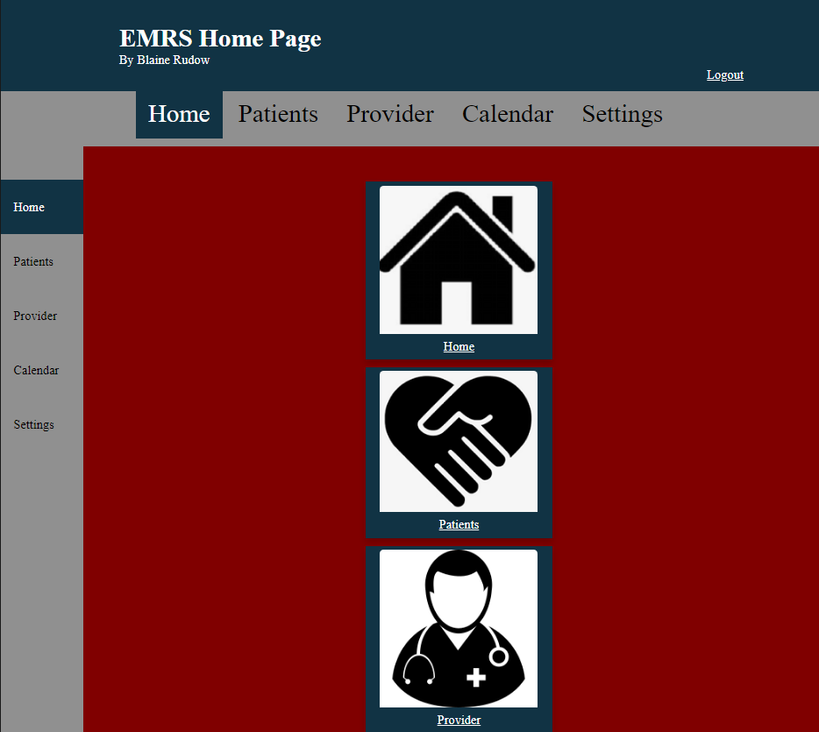
EMRS Home Page
Home page has several icons
Navigation bars on the top and left link to each other major feature
Logout button at the top right exists to exit the system

Slide 4
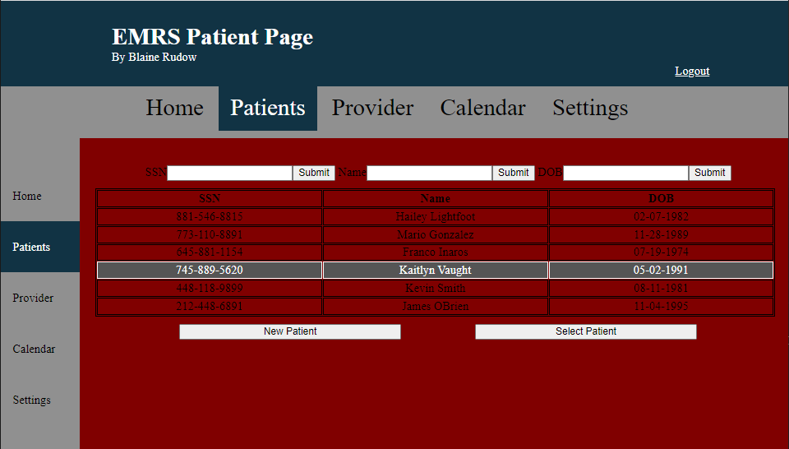
EMRS Patient Page
The Patient Page includes three search bars at the top of the content area where patients can be searched by their information.
The table provides a list of relevant patients
Two buttons at the bottom can select a patient to go to a specific patients chart, or new patient pulls up a form to create a new patient.

Slide 5
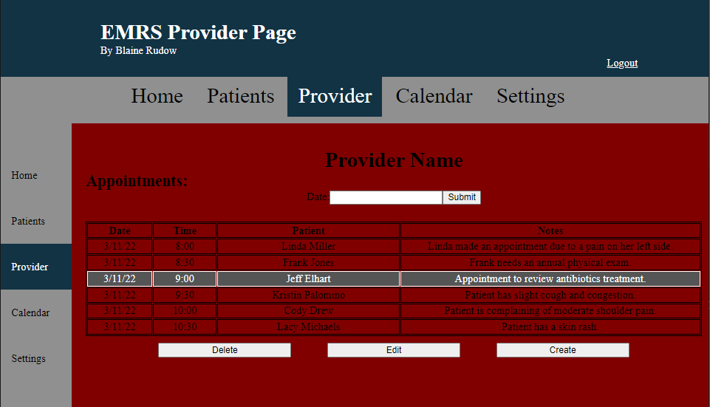
EMRS Provider Page
The top of the content lists the provider's name.
A search bar allows the provider to search by date to see listed appointments for that day.
The table lists the date, appointment time, patient, and notes about the patients upcoming appointment.
Three buttons at the bottom allow the provider to delete the appointment, edit the appointment, or create a new appointment.

Slide 6
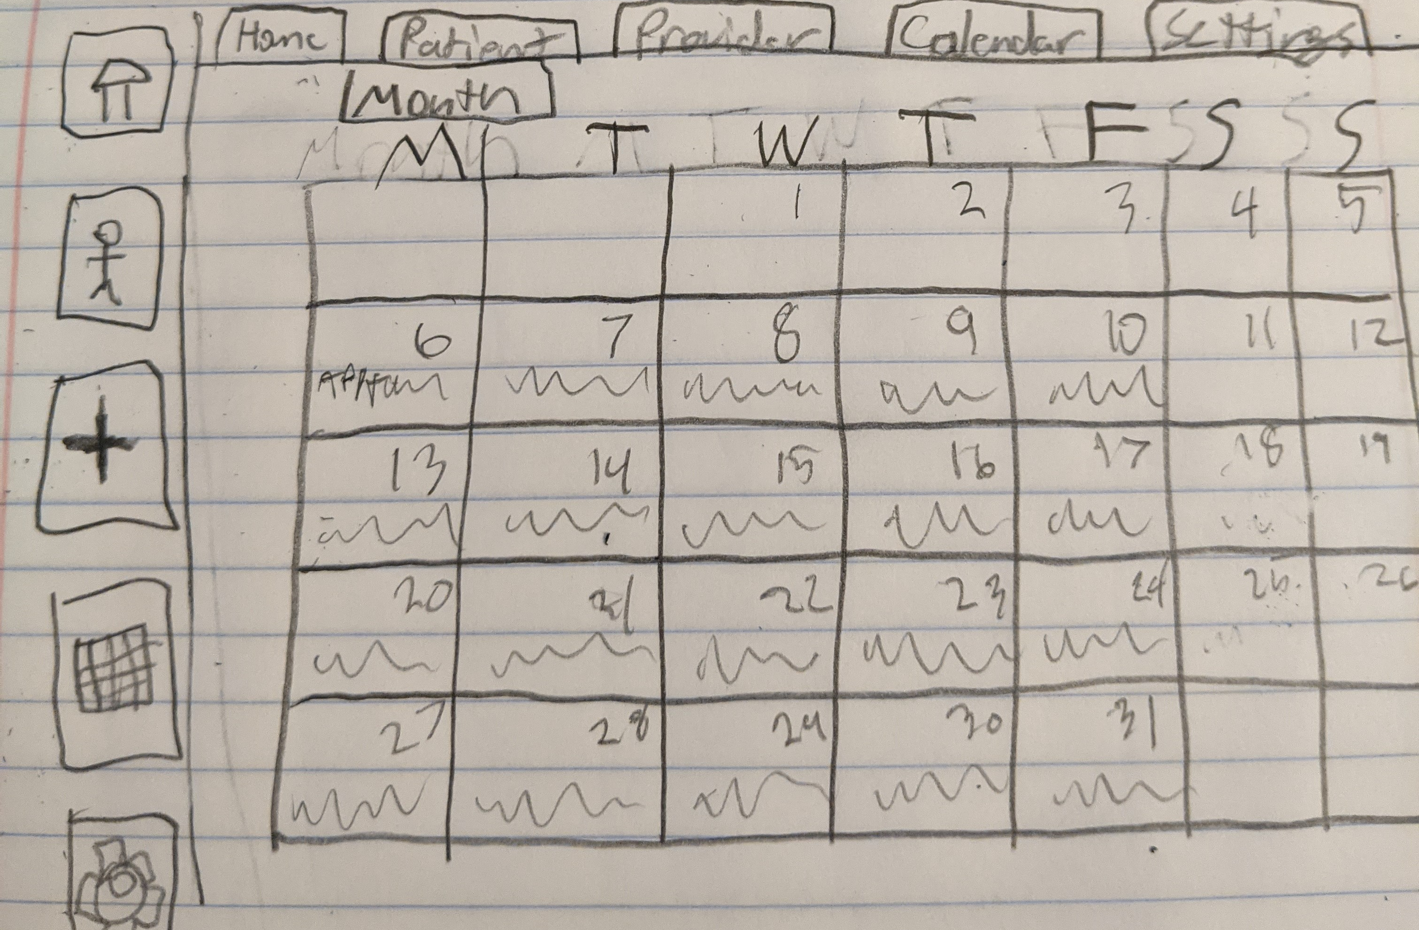
EMRS Calendar page
The Calendar Page is not yet complete.
Each cell in the calendar will be clickable so the provider can see the appointment data for that day.
A button at the top will allow the provider to sort through months.

